Slide 1


Defend & Attack
COIT11241 Cyber Security Technologies
Assignement - 3 – Final Présentation
By:
Krishan Himesh Abeyrathne – 12217274
Carl Khyncer Bhryn Yurong - 12224629
GitHub repository : https://github.com/KrishanHimesh/COIT11241-Asignment-2-ePortforlio-Krishan-and-Carl.git

Slide 2

Defend
Presented by: Carl Khyncer Yurong 12224629

Slide 3
Purpose
Providing step by step overview of how CIS allowlist works as a defender for the applications and how to run it.
It helps enhance system security by ensuring that only approved applications and scripts are allowed to execute. PowerShell, a versatile scripting and automation tool in Windows, enables administrators to implement and manage CIS allowlist policies efficiently.

Slide 4

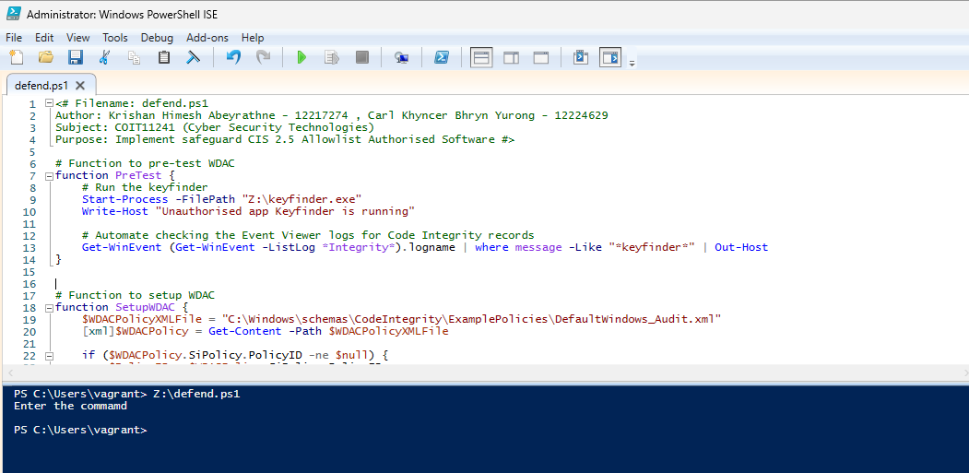
We have written the code and run it on the PowerShell ISE

Slide 5
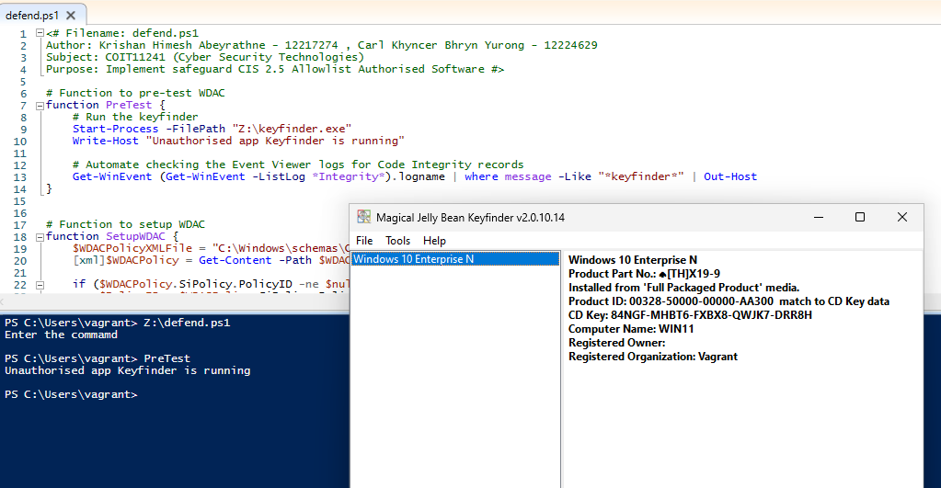
Run the pretest code

Slide 6
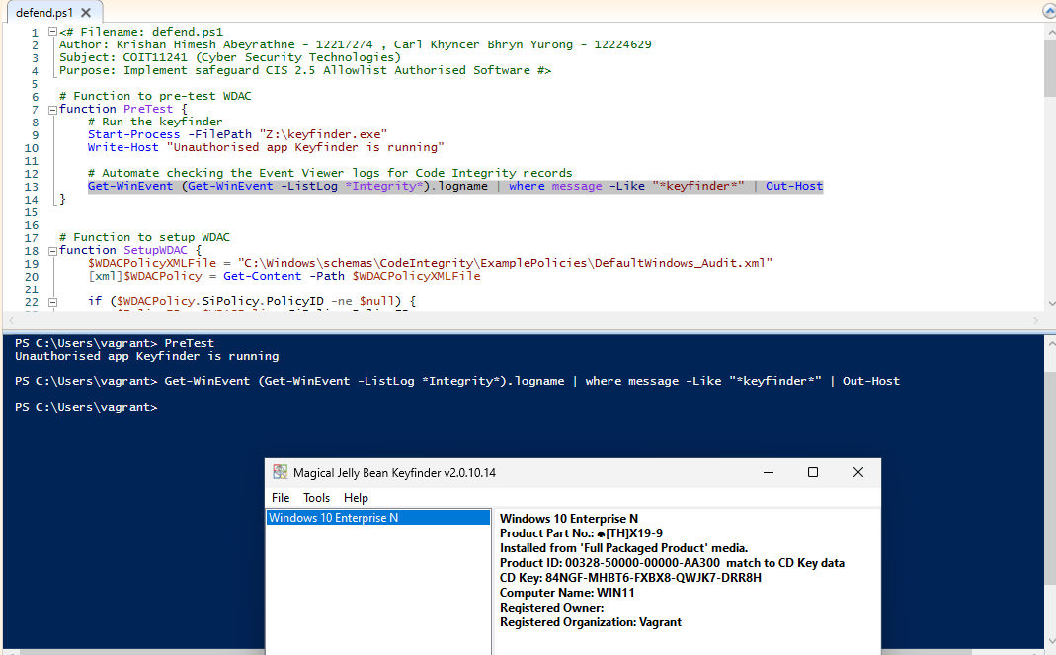
Checking the Win Event lost log for the keyfinder to check any logs entered

Slide 7
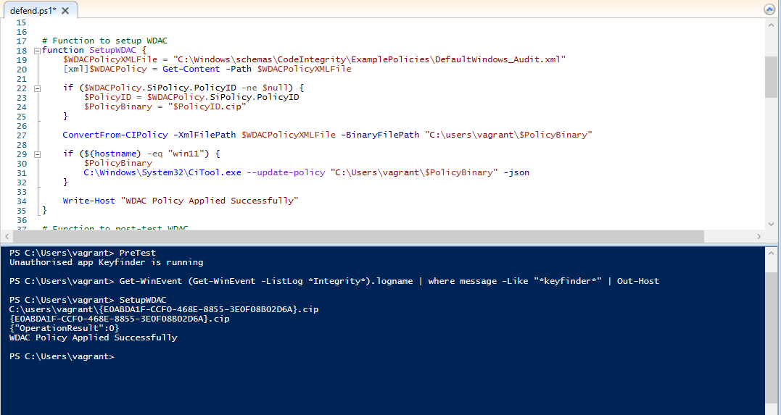
Then create the Windows Defender Application Control (WDAC) policy using DefaultWindows_Audit.xml and update the policy using citool.exe

Slide 8
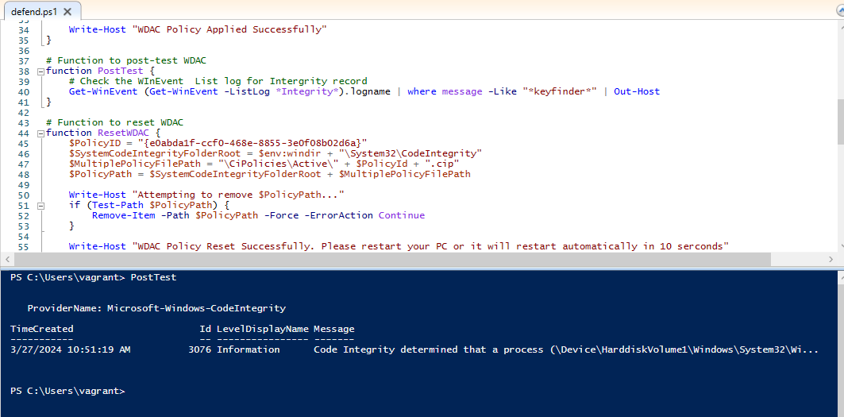
Then run the post-test to check the log list for the code integrity which is unauthorized application

Slide 9
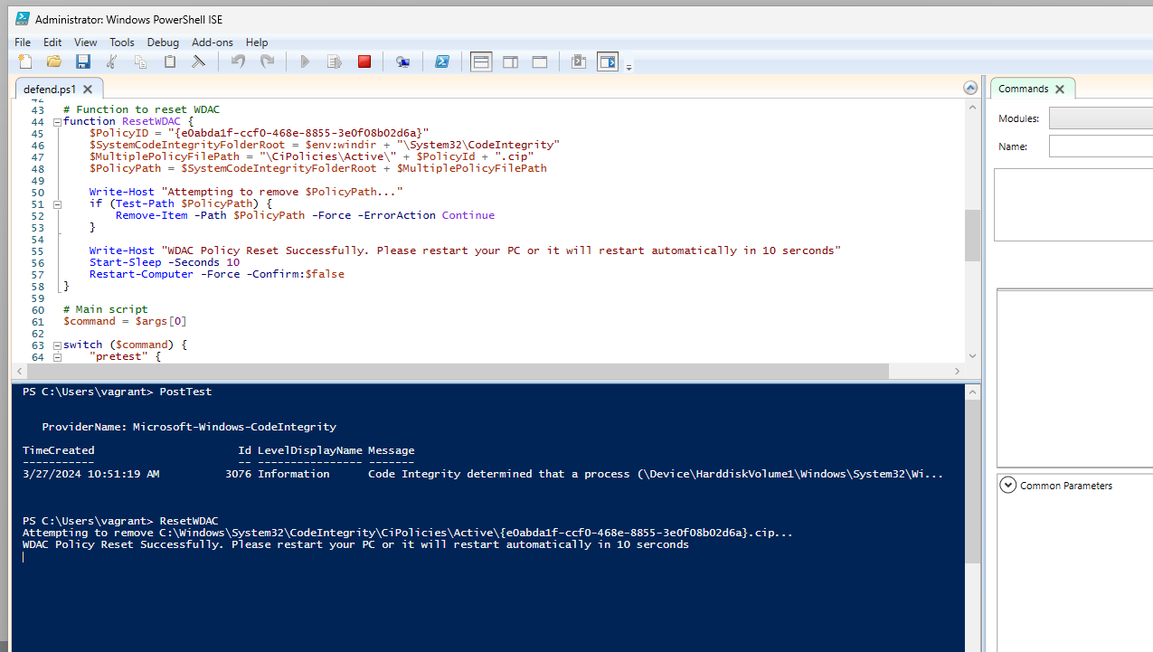
Reset WDAC

Slide 10
We cleaned the code as follows
Replace all ‘write-host ‘ with ‘Write-Output’
Replace ‘where’ with ‘where-object’
Delete white spaces

Slide 11
How is the system more resilient by running CIS allowlist control into the system?
CIS allowlist control enhances system resilience by ensuring only pre-approved applications run, reducing the risk of malware and unauthorised software execution (CIS 2022). This limits the system's attack surface, making it harder for attackers to exploit vulnerabilities, and provides administrators with greater control and visibility for effective monitoring and compliance with security policies.

Slide 12

Attack
Presented by: Krishan Himesh Abeyrathne - 12217274

Slide 13
Purpose
The purpose of this remote file copy attack simulation is to demonstrate the detection and response capabilities of a system against unauthorised data transfer activities. By simulating the copying of a file from a remote server to a local machine without proper authorisation, we showcase how Sysmon (System Monitor) effectively captures and logs these events. This simulation highlights the importance of monitoring and detecting suspicious file operations, enabling early detection of potential data breaches and quick incident response. Ultimately, it emphasises the need for robust security measures and continuous monitoring to enhance the overall security posture and resilience of the system.

Slide 14
Remote file copy (t1105)
This script is designed to emulate and defend against the MITRE ATT&CK technique T1105 (Remote File Copy) (MITRE 2024). T1105 involves adversaries copying files from one system to another over a network, which can be used for data exfiltration or to move tools and payloads within a compromised environment. By blocking SMB traffic and monitoring file copy attempts with Sysmon, this script helps identify and mitigate unauthorised file transfers, thereby enhancing the security posture against such lateral movement and exfiltration techniques.

Slide 15
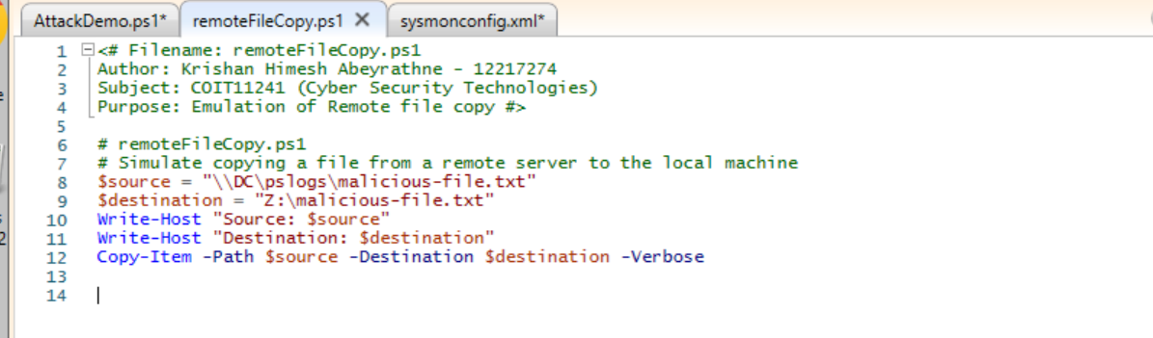
Malicious Remote Copy Script
This remote file copy script is used to copy a malicious file remotely from an external server to a system. The demonstration shows how it works and then monitors the Sysmon log to check its activity.

Slide 16
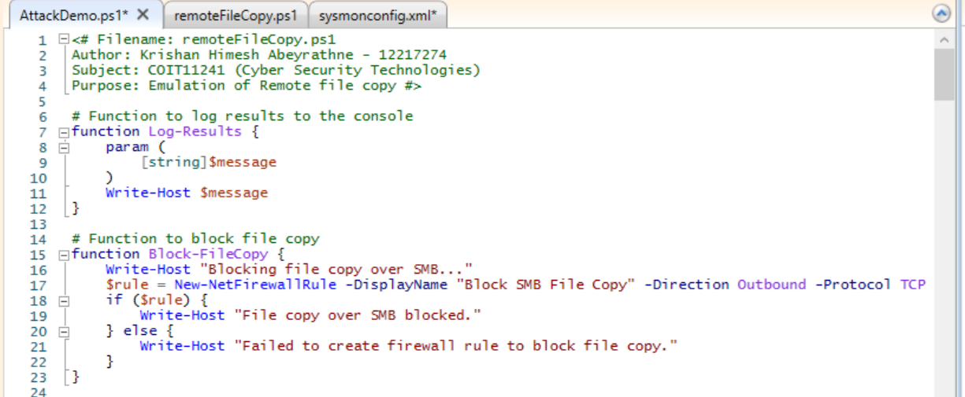
Attack Script – Block Remote file copy
This function creates a firewall rule to block outbound SMB traffic on port 445. This effectively prevents any file copy operations over SMB from the local machine to a remote machine.
The Log Result function is a simple logger that prints messages to the console. It helps keep track of what the script is doing at each step.

Slide 17
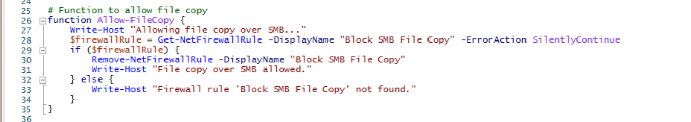
Allow File Copy
This function removes the previously created firewall rule, allowing SMB traffic again. This is necessary to test if the file copy operation can proceed once the rule is removed.

Slide 18
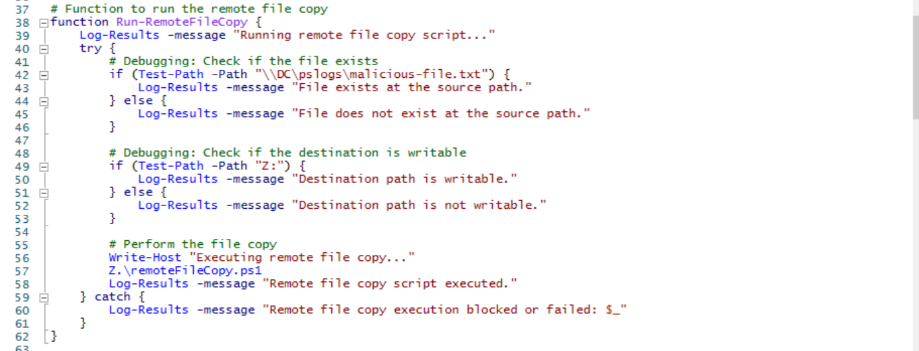
Allow to run the remote File Copy
This function attempts to execute the remote file copy script remoteFileCopy.ps1. It includes debugging steps to check if the source file exists and if the destination is writable. If any step fails, it logs the failure. The actual file copy is performed by calling remoteFileCopy.ps1.

Slide 19
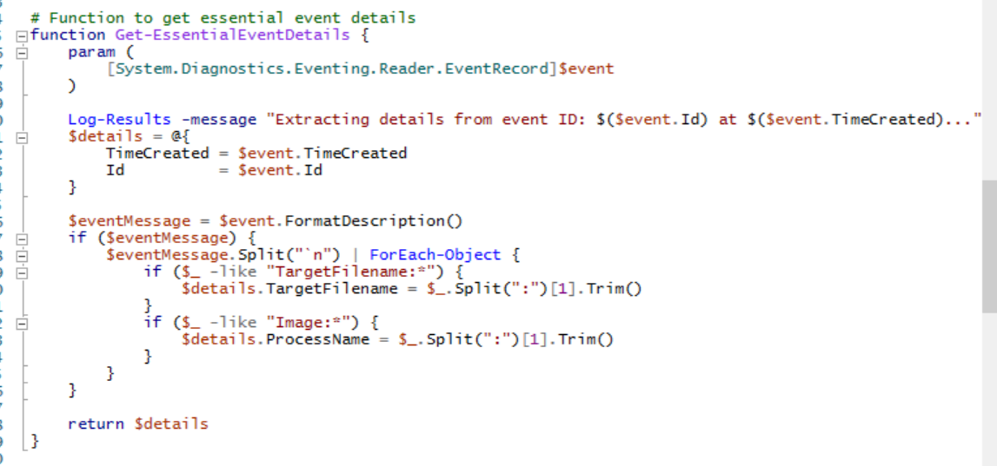
Extract Event Details
This function extracts essential details from a Sysmon event, including the time created, event ID, target filename, and process name. It helps to format and present the event details in a readable format.

Slide 20
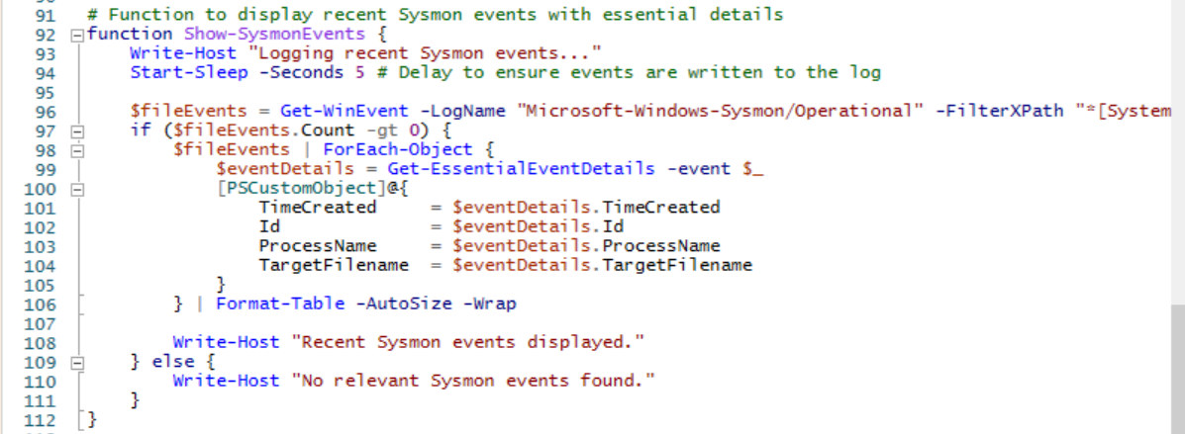
Get Sysmon Events
This function retrieves and displays recent Sysmon events related to file creation (event ID 11). It formats the events and prints them to the console. This helps demonstrate the detection of the file copy operation by Sysmon.

Slide 21
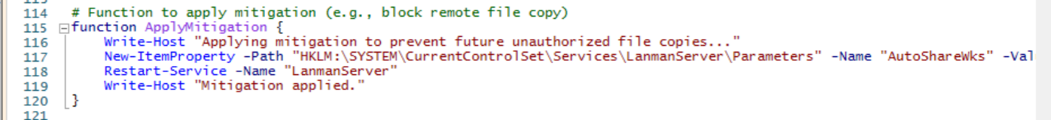
Apply Mitigation
This function applies mitigation by modifying the registry to disable administrative shares and then restarting the Lanman Server service. This helps to prevent unauthorised file copies over the network.

Slide 22
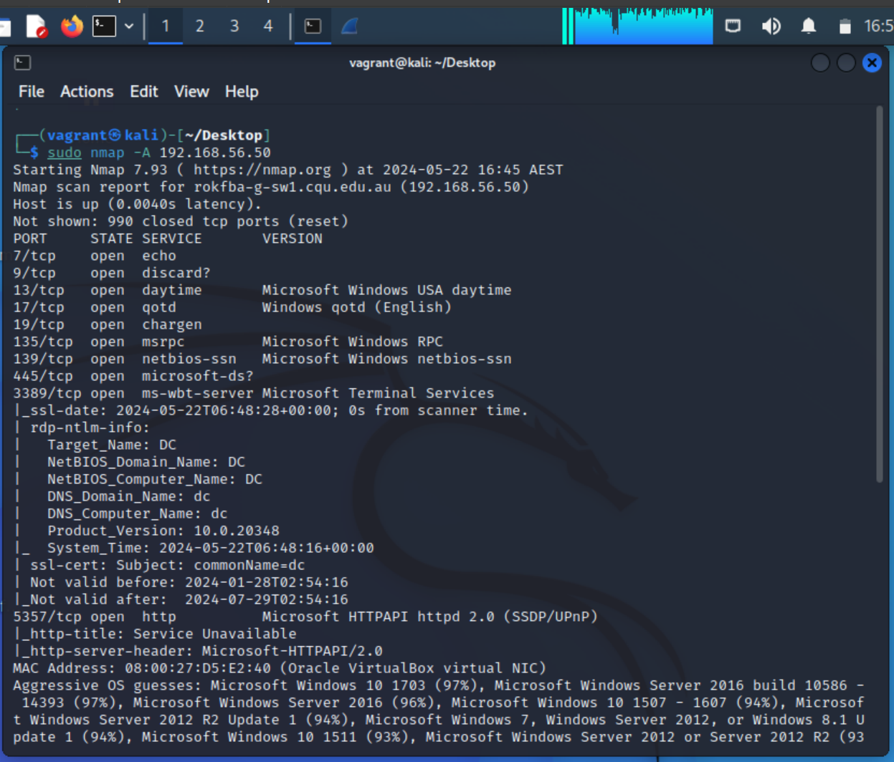
Use NMAP to scan the vulnerabilities
You can notice that port 445 is open in the system and the system is vulnerable to a remote file copy attack. To mitigate this vulnerability, we implemented a firewall rule that blocks outbound SMB traffic on port 445. By using this script, we can dynamically enable and disable the firewall rule to demonstrate the impact on file copy operations. Additionally, we monitor these activities with Sysmon to provide detailed logs of file operations, helping to detect unauthorised actions. This layered approach helps to secure the system against remote file copy attacks as described in the MITRE ATT&CK technique T1105.

Slide 23
Summary
In this demonstration, we showcased a security measure to prevent unauthorised SMB file transfers using a PowerShell script. We applied a firewall rule to block outbound SMB traffic on port 445, preventing unauthorised file copies and then removed the rule to allow legitimate transfers. Using Sysmon, we monitored and logged file operations to enhance our detection capabilities. Finally, we applied additional mitigations to prevent future unauthorised access. This demonstration highlights the importance of layered security measures to ensure robust network protection.

Slide 24
Reference
CIS 2022, CIS Control 16: Application Software Security, Viewed 22 May 2024, https://controls-assessment-specification.readthedocs.io/en/stable/control-16/index.html
Cybersecurity and Infrastructure Security Agency (CISA) 2024, Alert (AA22-181A) - Tactics, Techniques, and Procedures of Conti Ransomware, Viewed 21 May 2024, https://www.cisa.gov/news-events/cybersecurity-advisories/aa22-181a
Mitre Corporation 2024, CVE-2016-2183. Common Vulnerabilities and Exposures, Viewed 22 May2024, https://cve.mitre.org/cgi-bin/cvename.cgi?name=CVE-2016-2183
MITRE ATT&CK® 2024, Techniques - Enterprise, Viewed 22 May 2024,
https://attack.mitre.org/techniques/enterprise/

Slide 25

Thank You!

